Slide 1
Signposts
By: Carol Lynne Anderson

Slide 2
Contrasts and Contradictions
Why is the character doing that?
When you are reading and a character says or does something that’s opposite (or contradicts) what he or she has been saying or doing all along. This will help you with making predictions and inferences.

Slide 3
How might this change things?
Aha! Moment
When you are reading and suddenly a character realizes, understands, or figures something out.

Slide 4
Tough Questions
What does this question make me wonder about?
When you are reading and the character asks himself or herself a really difficult question.

Slide 5
Words of the Wiser
What is the life lesson and how might it affect the main character?
When you are reading and a character (who is normally older and wiser) takes the main character aside and gives him or her serious advice.

Slide 6
Again and Again
Why does this keep happening?
When you read and notice a word, phrase, or situation that is mentioned again and again.

Slide 7
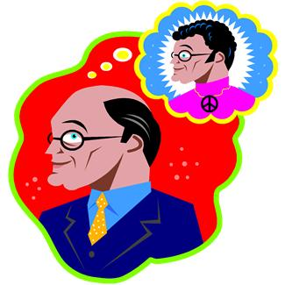
Memory Moment
Why might this memory be important?
When you are reading and the author interrupts the actions to tell you about a memory.

